Slide 1



Junit Fundamentals
May 2023
Version 1.0
This document is confidential and contains proprietary information, including trade secrets of CitiusTech. Neither the document nor any of the information contained in it may be reproduced or disclosed to any unauthorized person under any circumstances without the express written permission of CitiusTech.
© 2022 CitiusTech | Private & Confidential

Slide 2
Agenda
What is TDD?
About Junit
Assertions class
Basic annotations used in Junit5
About Mockito

Slide 3
What is Test Driven Development (TDD)?
Test Driven Development (TDD) is software development approach in which test cases are developed to specify and validate what the code will do.
Test-Driven Development starts with designing and developing tests for every small functionality of an application.
The simple concept of TDD is to write and correct the failed tests before writing new code (before development).
Test-Driven development is a process of developing and running automated test before actual development of the application. Hence, TDD sometimes also called as Test First Development.

Slide 4
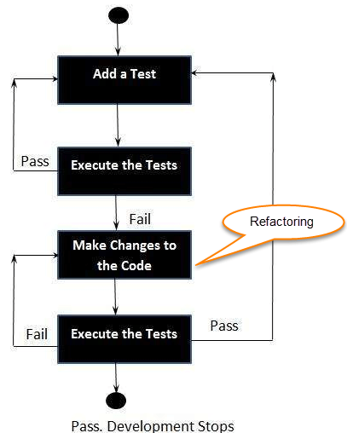
How to perform TDD test
Following steps define how to perform TDD test,
Add a test.
Run all tests and see if any new test fails.
Write some code.
Run tests and Refactor code.
Repeat.

Slide 5
Some of the best test driven development (TDD) frameworks
Junit
Mockito
TestNG
csUnit and Nunit
Rspec

Slide 6
Agenda
What is TDD?
About Junit
Basic annotations used in Junit5
Assertions class
About Mockito

Slide 7
What is Junit?
JUnit is an open source Unit Testing Framework for JAVA.
It is useful for Java Developers to write and run repeatable tests.
Once you are done with code, you should execute all tests, and it should pass.
Why you need JUnit testing?
It finds bugs early in the code, which makes our code more reliable.
JUnit is useful for developers, who work in a test-driven environment.
You develop more readable, reliable and bug-free code which builds confidence during development.
JUnit does not require server for testing web application, which makes the testing process fast.

Slide 8
Agenda
What is TDD?
About Junit
Basic annotations used in Junit5
Assertions class
About Mockito

Slide 9
Junit Annotations
@Test : Adding this annotation to a public void method allows us to simply run that method as a test..
@BeforeEach : A method annotated with @BeforeEach will run once before every test method annotated with @Test.
@AfterEach : A method annotated with @AfterEach should be executed after each test method.
@BeforeAll : A method annotated with @BeforeAll has to be a static method and it will run once before any test is run.
@AfterAll : Similar to @BeforeAll, but it runs after all the tests are run
@Disabled : This annotation can be applied to @Test methods to prevent them from running, or it can be even applied to a class to prevent all the @Test methods inside it from running.
@DisplayName : Declares a custom display name for the test class or test method

Slide 10
Junit Annotations
@SpringBootTest : @SpringBootTest annotation loads the complete Spring application context
@ParameterizedTest : Parameterized tests make it possible to run a test multiple times with different arguments. They are declared just like regular @Test methods but use the @ParameterizedTest annotation instead.
@MethodSource: This annotation allows us to load the inputs from one or more factory methods of the test class or external classes

Slide 11
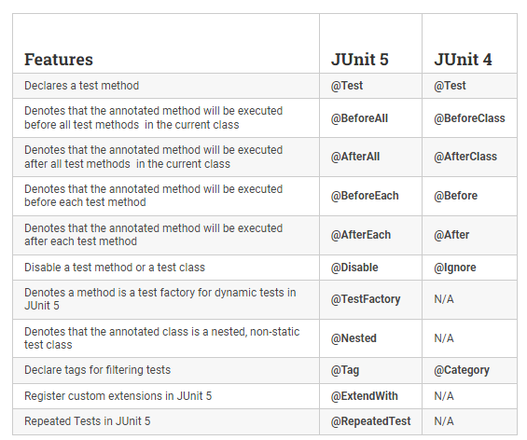
Junit4 VS Junit5 Annotations

Slide 12
Agenda
What is TDD?
About Junit
Basic annotations used in Junit5
Assertions
About Mockito

Slide 13
Junit Assertions
JUnit Jupiter assertions are kept in the org.junit.jupiter.api.Assertions class. All of the methods are static.
assertEquals(expected, actual) : This method compares two given parameters for equality.
assertNotEquals() : It checks for non-equality for two given parameters (primitives or objects).
assertNull(actual): It simply does a null check on the given parameter.
assertNotNull(actual) : Unlike, assertNull(), this fails if the given actual object is null.
assertTrue(expression) : It will fail if the given expression is false.
assertFalse(expression) : It will fail if the given expression is true.
assertThrows() : It checks a particular exception is thrown. It takes the class of the exception we are excepting (or one of its superclasses) as a first parameter. As for the second parameter it expects the code under test.
assertAll() : It will Group many assertions and every assertion is executed even if one or more of them fails

Slide 14
Agenda
What is TDD?
About Junit
Basic annotations used in Junit5
4. Assertions
5. About Mockito

Slide 15
Mockito Framework
Mockito is a mocking framework, JAVA-based library that is used for effective unit testing of JAVA applications.
Mockito is used to mock interfaces so that a dummy functionality can be added to a mock interface that can be used in unit testing.
The mocking technique is not only used in Java but also used in any object-oriented programming language.
There are many frameworks available in Java for mocking, but Mockito is the most popular framework
Benefits of Mockito
No Handwriting − No need to write mock objects on your own.
Refactoring Safe − Renaming interface method names or reordering parameters
will not break the test code as Mocks are created at runtime.
Return value support − Supports return values.
Exception support − Supports exceptions.
Order check support − Supports check on order of method calls.
Annotation support − Supports creating mocks using annotation.

Slide 16
Mockito Annotations
@Mock : @Mock annotation is used to create mock objects that can be used to replace dependencies in a test class.
@InjectMocks : @InjectMocks annotation is used to create an instance of a class and inject the mock objects into it, allowing you to test the behavior of the class.
@MockBean: @MockBean is used when the application context(in terms of testing) is up and you need to mock a service/Bean
@Spy : @Spy annotation is used to create a real object and spy on that real object.
@Captor : @Captor annotation is used to create an ArgumentCaptor instance which is used to capture method argument values

Slide 17
Junit Vs Mockito
JUnit is a unit testing framework that focuses on writing and executing test cases for individual units of code.
Mockito, on the other hand, is a mocking framework specifically designed to create mock objects for testing purposes
JUnit does not provide built-in mocking capabilities like Mockito and focuses more on assertions and testing individual code.
One of the key features of Mockito is its ability to create mock objects and stub or verify their behaviors
JUnit provides mechanisms to measure code coverage and assess the effectiveness of unit tests. Developers can use tools like JaCoCo or Cobertura to generate reports
Its primary focus is on creating mock objects and verifying interactions with them during testing.

Slide 18
References
https://www.google.com/development/tool/
https://www.youtube.com/watch?v=WeMrd3T7cRQ
https://reflectoring.io/junit5/

Slide 19
Thank you!

